Slide 1
Traffic detection and monitoring with traffic camera
Timo Tiirats
Xuejun Wu
Denys Kolomiiets

Slide 2
Project description
Try to analyse low-res cameras on the road to understand traffic patterns in the area using different ML methods, as well as video processing.

Slide 3
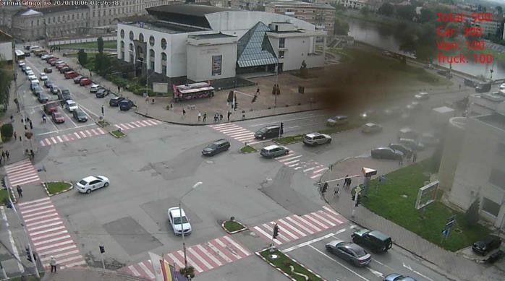
Example

Slide 4
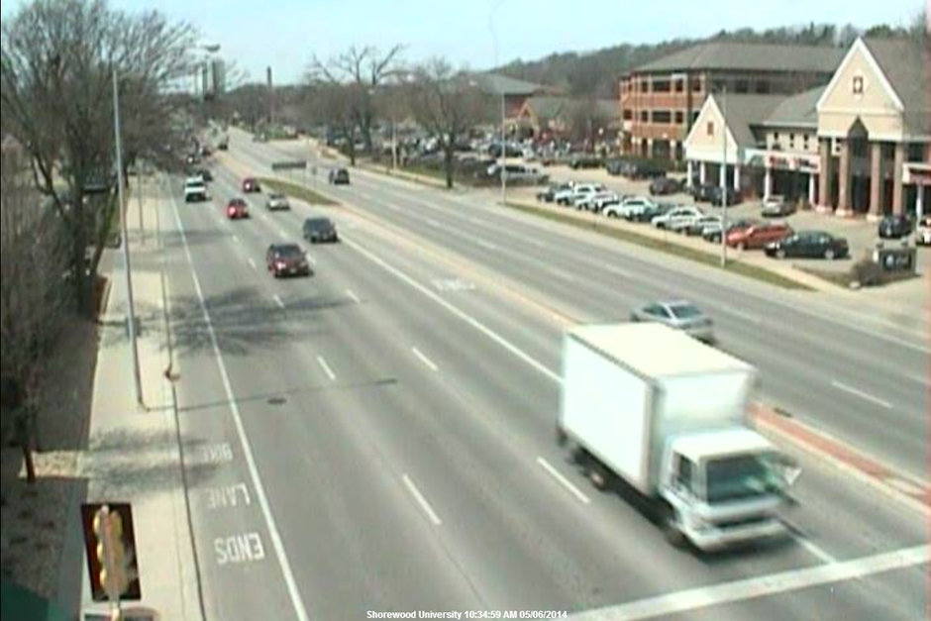
Example 2

Slide 5
Opportunities
Detect types of vehicle:
by size
ML algorithms
Evaluate the traffic density

Slide 6
Data to use
We have different sources for the project:
Insecam, where we can find a footage of a lot of roads
MIO-TCD dataset, a dataset of different traffic detection with traffic types. podoce.dinf.usherbrooke.ca/challenge/dataset

Slide 7
Challenges
Using the traffic cams can bring some challenges on the way:
low resolution
low framerate
highly dependent of the background

